Slide 1
Broadcast Technology UG1
4: Modulation, Multiplexing
Jerry Foss
jeremy.foss@bcu.ac.uk

Slide 2
Modulation,
AM, FM, Phase,
(QAM ... later on …)

Slide 3

Signals - baseband
voltage
TIME DOMAIN
time
voltage
FREQUENCY DOMAIN
20kHz
frequency

Slide 4
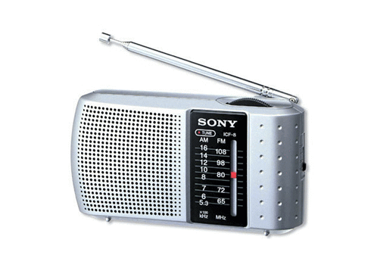
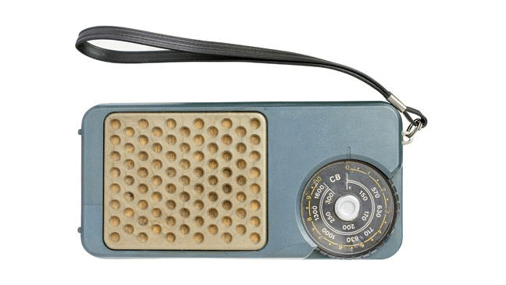
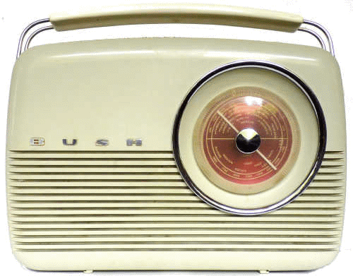
Carrier Waves
Receiver
carrier
frequency a
“tuned” to frequency a
Receiver
Transmitter
tuned to frequency b
Receiver
tuned to frequency c

Slide 5
Carrier Waves
carrier
frequency a
Receiver
carrier
frequency b
“tuned” to frequency a
carrier
frequency c
Receiver
Transmitter
tuned to frequency b
Receiver
tuned to frequency c

Slide 6
Modulation
Sports
modulated carrier
frequency a
Receiver
Sports
News
modulated carrier
frequency b
“tuned” to frequency a
Music
modulated carrier
frequency c
Receiver
Transmitter
News
tuned to frequency b
Modulation
Receiver
Music
tuned to frequency c
carrier wave
program signal

Slide 7
Modulation
To convey a Baseband signal on a Carrier signal
Necessary to allow a multitude of baseband signals to simultaneously exist
Carrier - sinusoidal
y = sin x
Wavelength = λ
= 1 cycle
Frequency ...
f = cycles/second
= Hertz, Hz

Slide 8
Signals
voltage
TIME DOMAIN
time
voltage
FREQUENCY DOMAIN
20kHz
frequency

Slide 9



Signals – transmitting more than one signal on a channel - multiplexing
voltage
time
voltage
20kHz
20kHz
frequency

Slide 10

Signals – transmitting more than one signal on a channel - multiplexing
voltage
20kHz
20kHz
20kHz
frequency

Slide 11
Signals – multiplexing
Each channel needs a separate carrier
f_{c1}
e.g. 200kHz
f_{c2}
e.g. 222kHz
f_{c3}
e.g. 244kHz
Includes 2kHz guardband
voltage
20kHz
20kHz
20kHz
frequency

Slide 12
Modulation
Carrier - sinusoidal
Carrier parameters can change to convey the baseband signal:
Amplitude
... Amplitude Modulation - AM
Frequency
… Frequency Modulation
- FM
Phase
… Phase Modulation
(PM and many other types)
y = sin x

Slide 13
Analogue Modulation – AM and FM

Slide 14
Amplitude Modulation - AM
Carrier Wave
+
Audio Signal
⬇
Amplitude Modulated Carrier
Transmitted AM signal

Slide 15
Amplitude Modulation
Carrier Wave Generator
⬇
⬇
Modulator
Transmitter
⬇
⬇
⬇
⬇
Audio
Programme

Slide 16
Amplitude Demodulation
Receiver
⬇
⬇
Receiver - antenna feeds a circuit tuned (i.e. sympathetic to the frequency of the desired carrier wave). The modulated carrier wave is retrieved
The demodulator – “tunes in” to the same frequency as the carrier, so retrieves the required baseband signal
Demodulator
⬇
⬇
Audio Stage

Slide 17
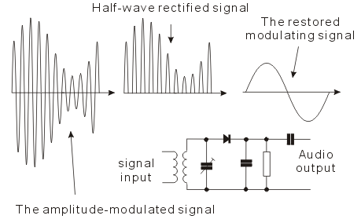
Amplitude Demodulation
Receiver
⬇
⬇
Demodulator
⬇
⬇
Audio Stage

Slide 18
AM Prone to Noise Interference
Noise interference hits
transmitted wave
… and alters the amplitude of the carrier
demodulated wave contains noisy spikes

Slide 19
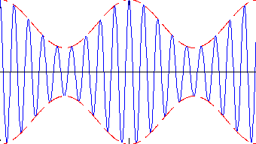
Modulation Index
The ratio of the depth of modulation
signal voltage = V_{s}
modulating signal
carrier voltage
= V_{c}
carrier
modulated carrier
Modulation Index = m =

Slide 20

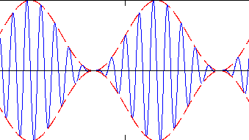
Modulation Index
Here, modulating signal V_{s} is half the magnitude of carrier voltage V_{c}
i.e. Carrier Voltage = V_{c}
… and V_{s} = 0.5 x V_{c}
∴ m = V_{s} / V_{c}
= 0.5v / v
= 0.5 (or 50%)
Here, the modulating signal V_{s} is the same magnitude as the carrier V_{c};
i.e. V_{s} = V_{c}
∴ m = V_{s} / V_{c} = 1 (or 100%)
note - the modulated wave reduces to zero

Slide 21
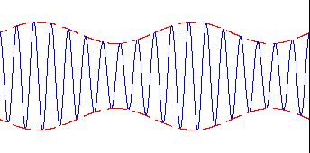
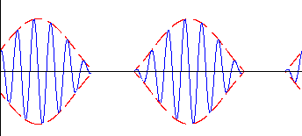
Modulation Index
Here the modulation index is 0.25
giving a fairly shallow modulated carrier wave
signal strength is low compared to noise (S/N ratio)
Here the modulation index is 1.5
- giving an over modulated carrier

Slide 22
Amplitude Modulation
Carrier Signal = v_{c} = V_{c} sinω_{c}t;
ω_{c}=2πf_{c} where f_{c}= carrier freq
Modulating Signal = v_{s} = V_{s} sinω_{s}t;
ω_{s}=2πf_{s} ; where f_{s} = modulation freq
So the voltage of the carrier varies between
(V_{c} + V_{m}) and (V_{c} - V_{m})
Modulation Index = m =V_{s} / V_{c;} so V_{s} = m V_{c}
v_{c} = (V_{c} + V_{s}sinω_{s}t) sinω_{c}t
= V_{c} sinω_{c}t + V_{s}sinω_{s}t . sinω_{c}t
since
sinω_{s}t . sinω_{c}t = ½ [cos(ω_{c} – ω_{s})t - cos(ω_{c} + ω_{s})t]
then
v_{c} = (V_{c} sin ω_{c}t) + ½ mV_{c} cos(ω_{c} – ω_{s})t - ½ mV_{c} cos(ω_{c} + ω_{s})t
Carrier Wave
+
Audio Signal
⬇
Amplitude Modulated Carrier
Transmitted AM signal

Slide 23
Amplitude Modulation
v_{c} = (V_{c} sin ω_{c}t) + ½ mV_{c} cos(ω_{c} – ω_{s})t - ½ mV_{c} cos(ω_{c} + ω_{s})t
Carrier + USB - LSB
Power
LSB =
Lower Side Band
USB =
Upper Side Band
f_{c} - freq range of signal
f_{c} + freq range of signal
f_{c}

Slide 24
AM Frequency Spectrum - Sidebands
AM process produces a spectrum containing the carrier and two sidebands of frequencies related to the modulating signal
e.g.:
Power
LSB =
Lower Side Band
USB =
Upper Side Band
f_{c} - freq range of signal
f_{c} + freq range of signal
f_{c}
e.g. modulating signal is between 100Hz and 8KHz,
and carrier freq = 600KHz (=600,000Hz)
Then - USB extends up from [600,000 + 100]Hz to [600,000 + 8,000]Hz
= 600.1KHz up to 608KHz
LSB extends down from [600,000 – 100]Hz to [600,000 – 8,000]Hz
= 599.9KHz down to 592KHz

Slide 25
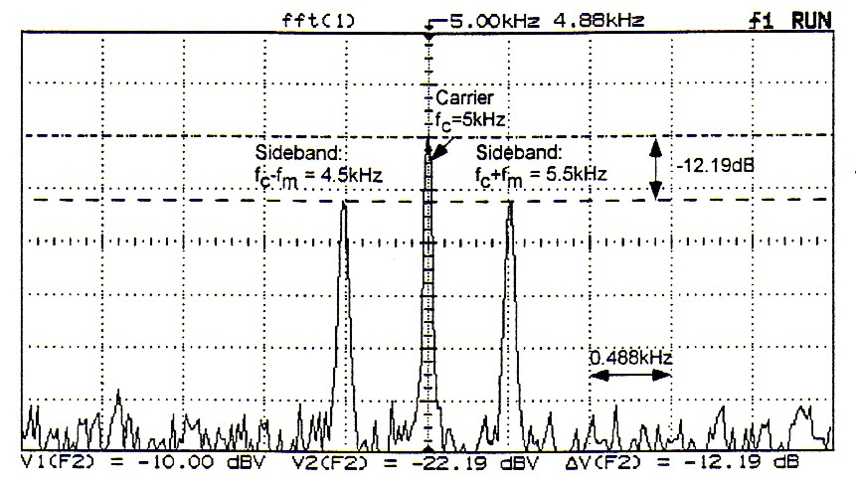
AM Frequency Spectrum - Sidebands
Signal frequency, f_{m} = 500Hz
Carrier frequency
f_{c} = 5KHz
Sideband at f_{c}-f_{m} = 5KHz-500Hz = 4.5KHz
Sideband at f_{c}+f_{m} = 5KHz+500Hz = 5.5KHz

Slide 26
Frequency Modulation
Unmodulated
Carrier Wave
Audio Signal
Frequency Modulated Wave
i.e. carrier freq increases with audio signal amplitude

Slide 27
FM Demodulation
Received signal
S(t)
Limited and filtered
signal
Zero Crossing Detection
Fully rectified signal
Pulse Generator
Low Pass Filter
Regenerator Threshold
Regenerated baseband
signal
S_{m}(t)

Slide 28
Frequency Modulation – Modulation Index
Often denoted as β
indicates how much the frequency of the carrier will deviate in relation to the frequency of the modulating signal
i.e.
β = = the change of frequency / frequency of the carrier
e.g. β=5 means the frequency of the modulated carrier will deviate
by 5x the modulating signal
e.g. if freq range of the signal is 20Hz to 15KHz (i.e. typical FM spec)
then the frequency of the carrier will deviate by 100Hz up to 75KHz

Slide 29
Frequency Modulation - Immunity to noise
Transmitted FM signal
Noise-hit FM signal
Amplitude of signal is corrupted...
... however - frequency of signal is still intact:
Since we are only interested in the frequency of the carrier, the original audio signal can still be recovered

Slide 30
Spectrum of an Analogue PAL TV Transmission

Slide 31
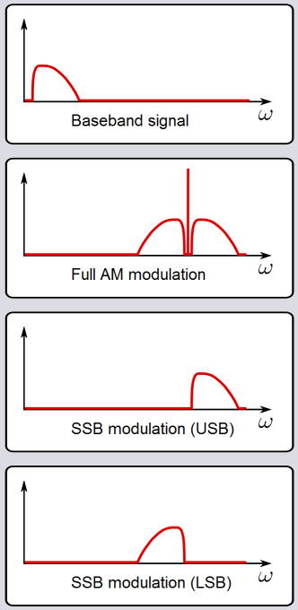
Sidebands – Single, Vestigial
SSB produced by filtering one of the sidebands, usually the lower (LSB)
Carrier is also often reduced or removed entirely (suppressed)
= single sideband suppressed carrier (SSBSC)
No information is lost in the process
Radio frequency transmission is now concentrated in a single sideband
∴ effective power output is greater than in normal AM
(since the carrier and redundant sideband account for well over half of the power output of an AM transmitter)
Requires special reception to demodulate

Slide 32
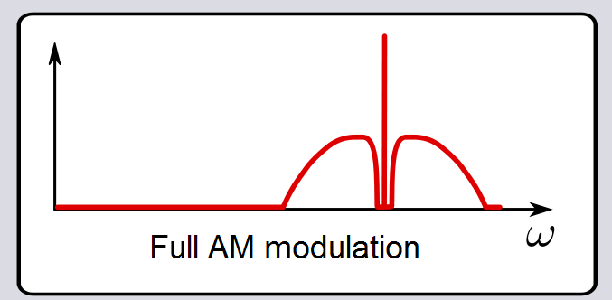
Vestigial Sideband (VSB)
sideband that has been only partly cut off or suppressed
to reduce the large bandwidth of the original video signal
also be used in digital transmission, such as the ATSC standardized 8-VSB
by the RF and IF filters
For video - SSB would be desirable
... but the video signal has significant low frequency content, plus square sync pulses
... so some of the lower sideband is retained
VSB - full upper sideband of bandwidth transmitted = 4MHz
... but only 1.25MHz of the lower sideband is transmitted, plus the carrier
effectively makes the system AM at low modulation frequencies and SSB at high modulation frequencies
absence of the lower sideband components at high frequencies must be compensated for, and this is done by the RF and IF filters

Slide 33
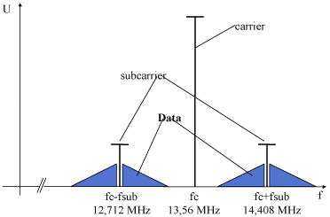
Sub Carriers
The subcarrier is modulated with a signal, the resulting signal is then modulated onto main carrier. (i.e. two levels of modulation)
(This example is actually for contactless payment systems, but the principle is common for subcarrier modulation)
sub carrier is 848kHz below main carrier
sub carrier is 848kHz above main carrier

Slide 34
PAL Signal Spectrum
Colour Sub-Carrier
(suppressed)
5.68MHz
Chroma coding (QAM)
Vision Carrier
1.25MHz
(AM / VSB)
Sound Centre Freq
6.75MHz
(FM)
freq
7.0MHz
Vestigial Sideband
Full Sideband

Slide 35
Broadcast Channels Frequency Spacing
7Mhz TV Channel
8Mhz Spacing
Ch21
48 channels
Ch68
475MHz
850MHz

Slide 36

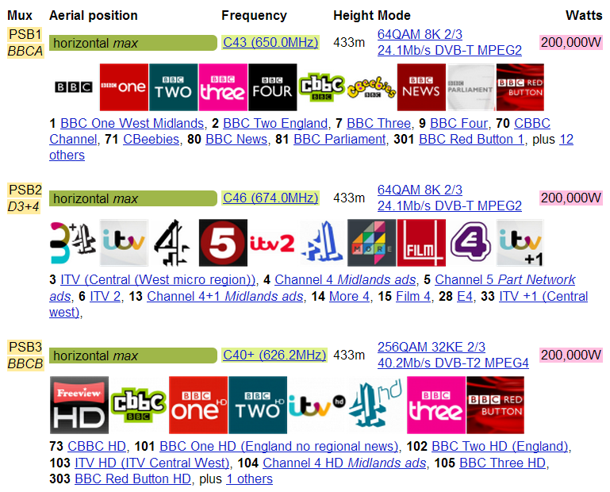
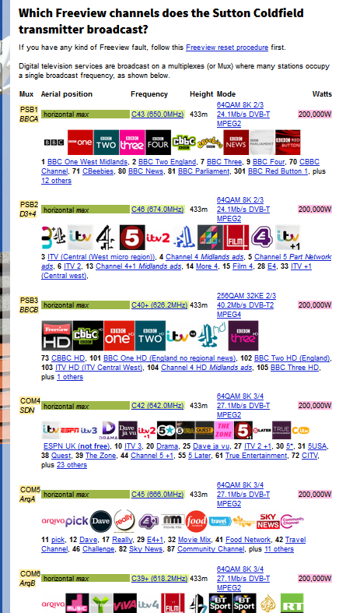
http://www.ukfree.tv/txdetail.php?a=SK113003

Slide 37
Multiplexing:
FDM, TDM
Statistical
Multiplexing: combination of signals to transmit on a common bearer / channel

Slide 38
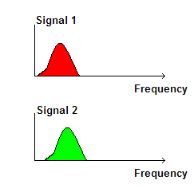
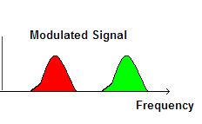
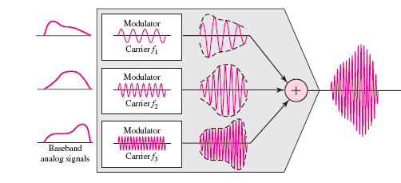
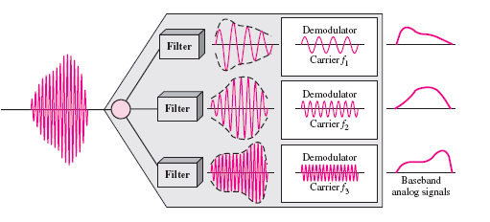
Multiplexing - Frequency Division Multiplexing (FDM)
Each signal is modulated onto a different frequency (subcarrier )
“baseband”
signals
i.e. unmodulated original signal
f₁ f₂

Slide 39
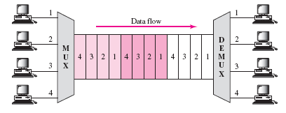
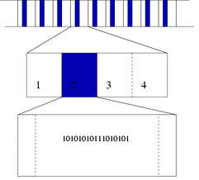
Multiplexing - Time Division Multiplexing (TDM)
Multiple signals are interleaved (in bits or blocks) over time
Data streams divided into frames
Frames divided into time slots
Each user is allocated one time slot
Time slots contain data with guard period if needed for synchronisation
2
1
3
4

Slide 40
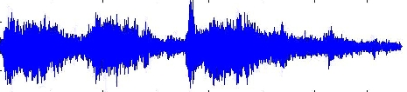
Time Division Multiplex
4kHz voice sampled at 8kHz (fs) into 8 bits binary
Analogue – Digital: Samples are dropped into allocated timeslot for each frame
TS6 next frame
TS6 previous frame
TS6 this frame
010100101
010100101
01001001
10010001
10110011
010100101
10010001
01001001
010100101
010100101
01001001
TS1 TS2 TS3 TS4 TS5 TS6 TS7 TS8 ………………………………………………………………….
e.g. for UK / European E1 Multiplexes:
30 channels of speech into 32 channel frame “Multiplex”
32 channels x 8b x 8kHz = 2.048Mbs-1
(includes 1 channel signalling and 1 channel synchronisation)

Slide 41
Multiplexing - Statistical Multiplexing
Statistical Multiplexer
Source A
Source B
Source C
Source D
Source E
Input buffer
Input buffer
Input buffer
Output buffer
Outgoing Port:
Packets are placed on the outgoing channel
Input buffer
Input buffer
Incoming ports: Data blocks arrive asynchronously from variable-rate sources
Input buffers smooth fluctuation in input data rates
Headers containing addresses and other information are added to the data blocks – to form packets
Packets are then fed to the output buffer

Slide 42
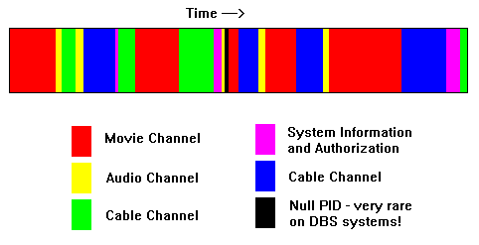
Multiplexing - Statistical Multiplexing
e.g. DVB multiplex:
Packet format: Control, management and content assigned into fields
Start
Flag
Address
Field
Control
Field
Information
Payload
Error
Control
End
Flag

Slide 43
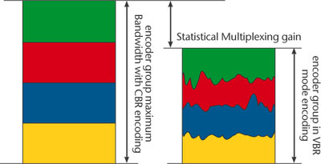
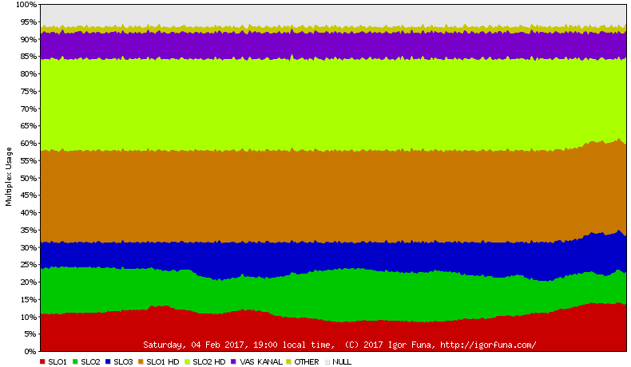
Statistical Multiplexing
Dynamic capacity allocation
Variable Bit Rate – VBR
one channel capacity reallocated to meet immediate service needs of other channels
allow additional elementary bit streams to be added at the input of the multiplexer
... or allow elementary bit streams to be multiplexed at a second stage
http://igorfuna.com/dvb-t/slovenia/multiplex-a-usage-chart

Slide 44
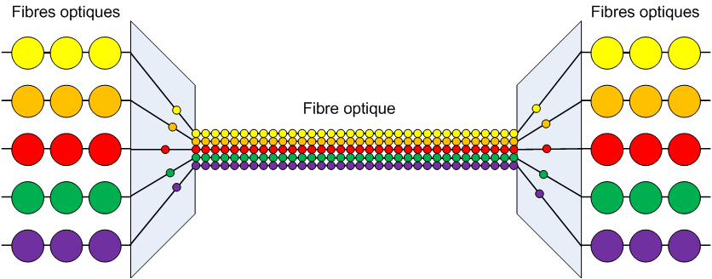
WDM – Wave Division Multiplexing
A number of multiplexes (each of many channels) are carried on one fibre
Each multiplex is a string of data
each on it’s own wavelength
Uses single mode fibre
Sources
Receivers
Fibre Optic

Slide 45
Modulation for
Digital Data

Slide 46


Modulation for Digital Data
objective:
We need to transmit a digital file of 00010101100110101000101010100101100110101…
can’t transmit “neat” digital 1’s and 0’s from a transmitter
(or receive them at a receiver)
transmission technologies operate only on analogue signals
we also need to retain the carrier frequency concept to allow for many stations
so carry 1’s and 0’s on analogue signals:

1 0 1 1 0 0 1

1 0 1 1 0 0 1 0 0 1 0 0 1 0 0 0 1 1 0 0 1
… often at hundreds of Mbits/s

Slide 47

e.g: Analogue TV … to Digital TV
Analogue TV Signal Spectrum
Frequency spectrum (range) for Analogue TV broadcast:
video signal (luminance + colour)
audio signal
7.0MHz
frequency

Slide 48
Broadcast Channels Frequency Spacing
7Mhz TV Channel
8Mhz Spacing
UHF band
Ch21
48 channels
Ch68
475MHz
850MHz

Slide 49
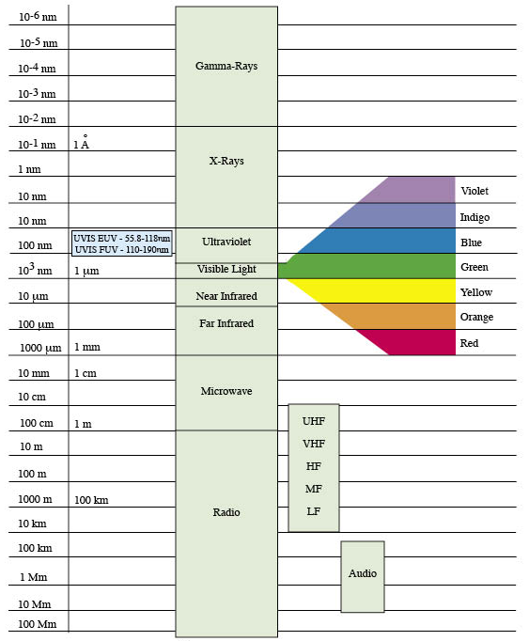
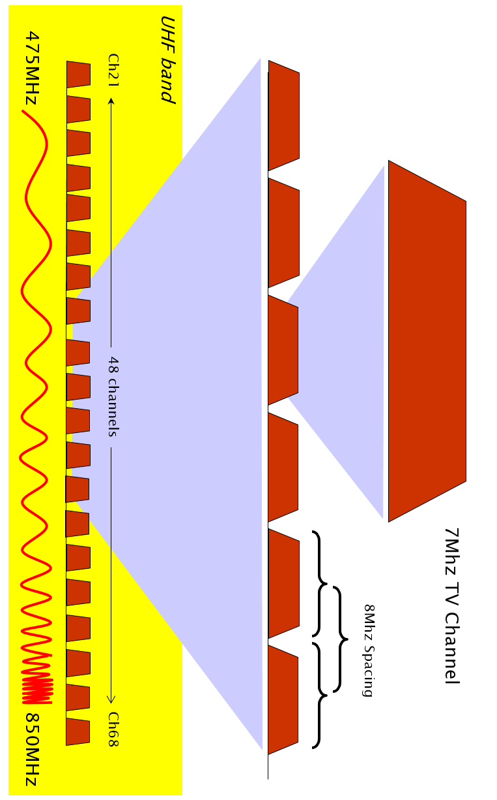
UHF TV in the Electromagnetic Spectrum

Slide 50
http://www.ukfree.tv/txdetail.php?a=SK113003

Slide 51
Ch21
48 channels
Ch68
475MHz
850MHz

Slide 52
Digital Data on Analogue Carrier e.g. Phase Shift Keying (PSK)
1 0 1 1 0 0 1
Digital Data
… is modulated
on to a
t
Analogue
Carrier
Binary PSK (there’s various formats):
Phase Coherent
180 180 0 180 0 180
Differential
90 270 270 90 90 270

Slide 53
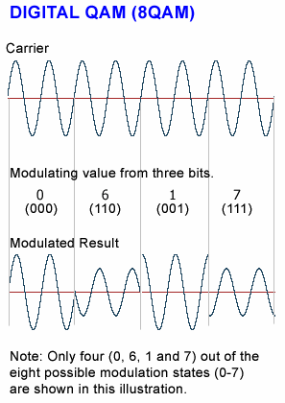
The Transmitted Signal
Shown here – 8 QAM
i.e. eight digital codes can be transmitted:
000, 001, 010, 011, 100, 101, 110, 111
So transmit the signal 000110001111:
…break it into the groups of codes available
000 110 001 111

Slide 54

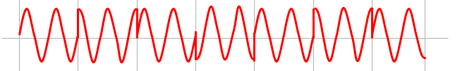
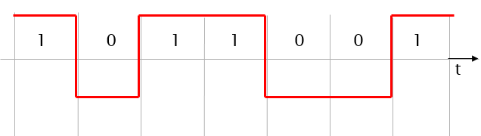
Digital Transmission
Carrier Wave Generator
⬇
⬇
Modulator
Transmitter
⬇
⬇
⬇
⬇
Receiver
Digital
Data
Receiver tunes into carrier, detects phase changes, retrieves data
⬇
Data retrieval, etc

Slide 55
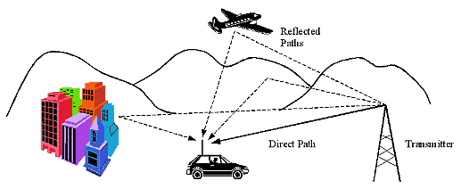
Inter-Symbol Interference for Modulated Data
Causes
multipath interference, including atmospherics
channel gain variations
signal spreading over a transmission line
jitter and other timing issues

Slide 56
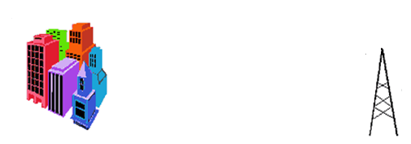

Inter-Symbol Interference for Modulated Data
+ =
+ =
Path difference – results in phase difference

Slide 57
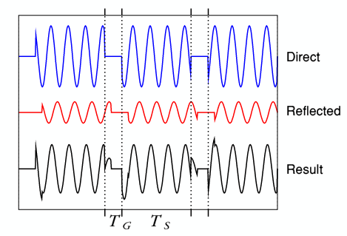
Inter-Symbol Interference for Modulated Data
Symbol n
Symbol n+1
Path 1
Symbol n+4
Symbol n+5
Symbol n+2
Symbol n+3
Symbol n
Symbol n+1
Symbol n+2
Path 2
Symbol n+4
Symbol n+5
Symbol n+3
echo delay time
Path 1+2
intersymbol interference

Slide 58
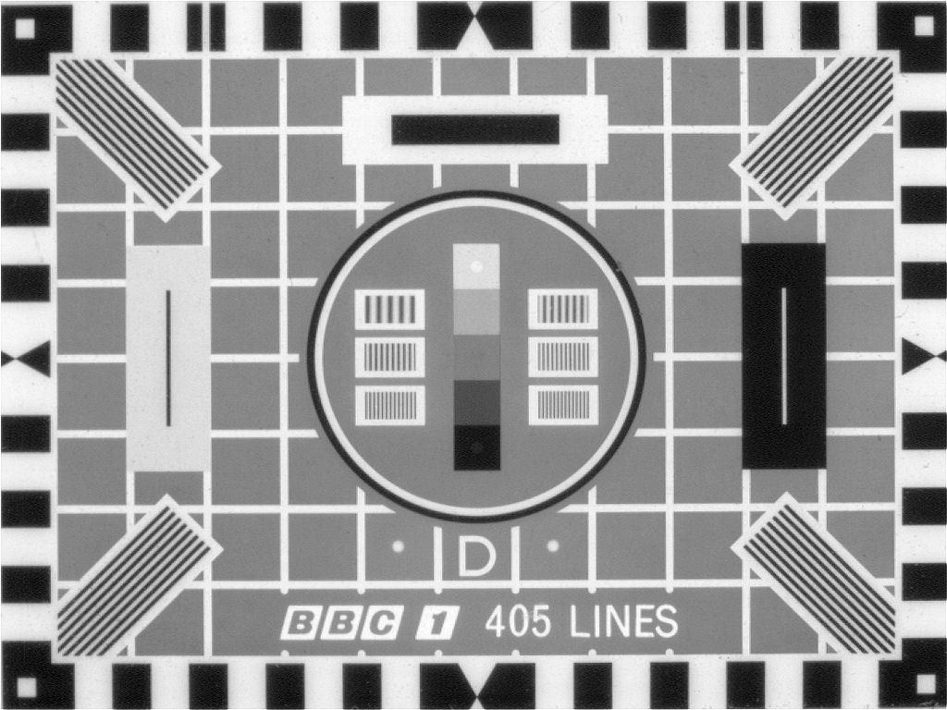

Slide 59
Advanced: QAM (later in the Course)

Slide 60
The Carrier for Digital – Still a Sinusoidal Wave
0°…… 90°……180°..…270°…360°
Carrier wave
e.g. for Digital Terriestrial TV = 475 – 850 MHz
… for Bluetooth = 2.4GHz
… for Wifi = 2.4GHz and 5GHz
… for DSL broadband – many frequencies (OFDM)

Slide 61
Phase Changes In A Sinusoidal Wave
0°…… 90°……180°..…270°…360°
Changes in phase (and amplitude) of a carrier can be used to denote digital code information
e.g. +90° = “1”; +270 ° = “0”
(but it gets more sophisticated than that!)
90° phase change (advanced)
270° phase change
(advanced)

Slide 62
Phase Changes In A Sinusoidal Wave
0°…… 90°……180°..…270°…360°
90°
90° phase change
Signal was to be transmitted here …
But it has been moved forward (advanced) by 90°

Slide 63
Constellation Diagrams
A graphical representation of digital codes corresponding to amplitude and phase-change in the carrier signal
90° phase advance
270° phase advance
90°
180°
0°
e.g. a signal with 90° and 270° phase changes:
270°

Slide 64
Amplitude Changes – Constellation Diagram
… an additional way to convey digital coded information
0°………………90°…………….180°……………..270°…………….360°
90°
180°
0°
i.e. red wave increases to twice the amplitude of green, but is still in phase at change
270°

Slide 65
Phase and Amplitude Changes
0°………………90°…………….180°……………..270°…………….360°
90°
180°
0°
i.e. red wave is half the green amplitude, and has advanced by 90°
270°

Slide 66
Constellation Diagrams
90°
Decision Thresholds
0
180°
0°
1
270
Two phase changes - 90° & 270°
allows intelligence – i.e. binary information – to be defined in these carrier changes
two changes in state – allows two coded bits: 1 & 0

Slide 67
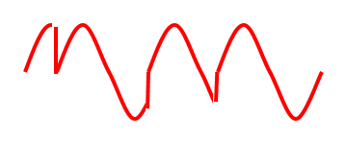
Constellation Diagrams
Decision Thresholds
90°
90°
0
11
01
180°
0°
180°
0°
1
10
00
270
270°
Four phase changes - 45°, 135 °, 225 °, 315 °
i.e. four changes in state, allows two coded bits per symbol:
00, 01, 10, 11
Problem: The receiver has to detect smaller phase changes
Two phase changes - 90° & 270°
i.e. two changes in state, allows
two coded bits: 1 & 0

Slide 68
Constellation Diagrams
If the phase change falls within this range, it represents a signal “01”
i.e. a fairly wide decision threshold
90
11
01
180
0
10
00
270

Slide 69
QAM – Quadrature Amplitude Modulation
90
16-QAM
16 decision points
4 coded bits per symbol
180
0
270
Used in Cable TV, IPTV, Satellite TV, WiFi
... most digital transmisions

Slide 70
16-QAM
0000
0001
0010
0011
90
Vector:
Angle = Phase
16-QAM
16 decision points
4 coded bits per symbol
Length = Amplitude
180
0
0100
0101
0110
0111
For example
Decision
Thresholds
270
Phase change can fall within this (small) range
Decision
Thresholds

Slide 71

64-QAM
e.g. a phase/ amplitude shift represented by this point = (say…) “100101”
90
64-QAM
64 decision points
6 coded bits per symbol
Decision
Thresholds
180
0
270
More digital bits - more information transmitted
More fragile signal (I.e. than 16QAM)-
will suffer in a poor transmission
results in more messages retransmitted
Decision thresholds

Slide 72
256-QAM
90
256-QAM
256 decision points
8 coded bits per symbol
180
0
Decision
Thresholds
e.g. a phase/ amplitude shift represented by this point = (say…) “10010111”

Slide 73
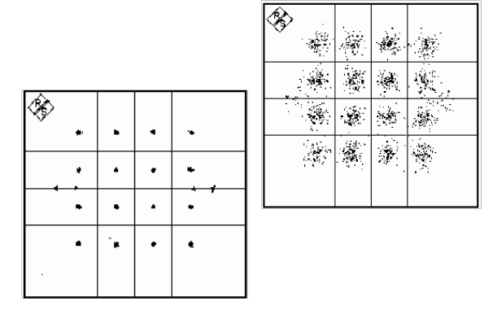
16-QAM Potential Errors
... due to phase and amplitude variations caused by transmission vaguaries
Left – ideal reception of signal
Above – more practical reception

Slide 74
The Transmitted Signal
Shown here – 8 QAM
i.e. eight digital codes can be transmitted:
000, 001, 010, 011, 100, 101, 110, 111
So transmit the signal 000110001111:
…break it into the groups of codes available
000 110 001 111

Slide 75
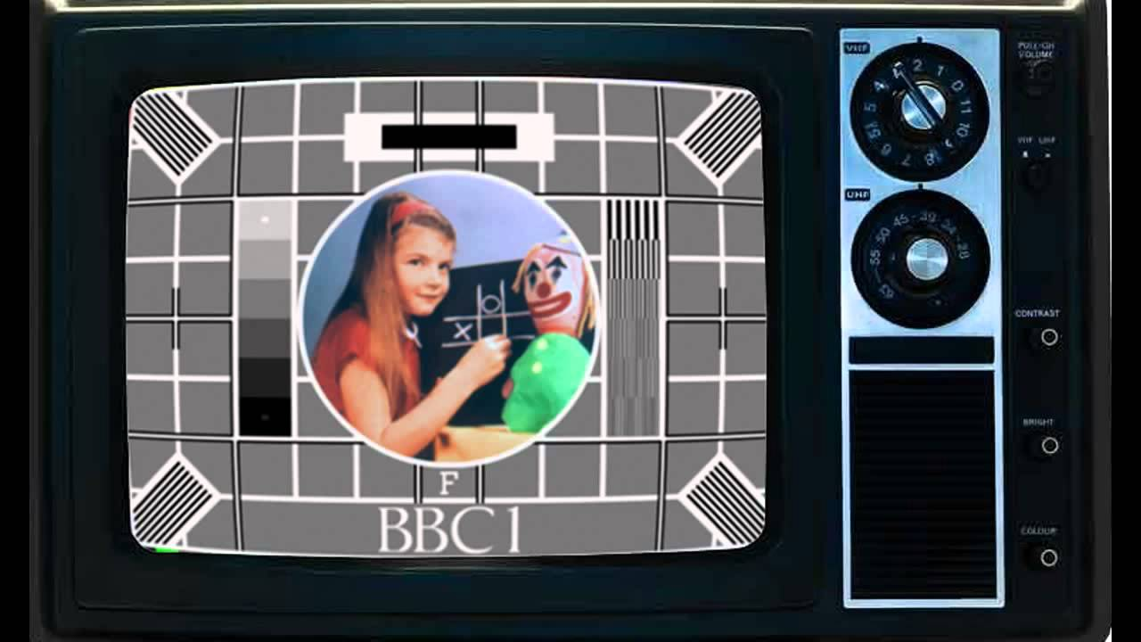

Slide 76
